Slide 1
Hybrid force-vision control
for da Vinci simulator
L. Cappella
M. Cirillo
R. Rinaldi

Slide 2
Problem Description
L. Cappella M. Cirillo R. Rinaldi

Slide 3
Scenario
Task requiring contact with the external dynamic and/or unknown environment
Different sensors in order to deal with it :
vision sensor : information on the spatial arrangement of different objects,
force sensor : local information.
HOW TO EFFECTIVELY COMBINE THEM?
L. Cappella M. Cirillo R. Rinaldi

Slide 4
A literature review
L. Cappella M. Cirillo R. Rinaldi

Slide 5
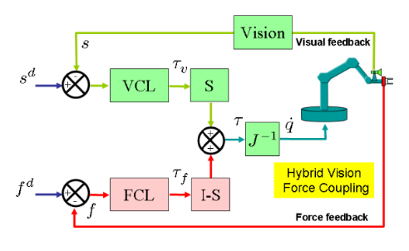
The hybrid-based control scheme
L. Cappella M. Cirillo R. Rinaldi

Slide 6
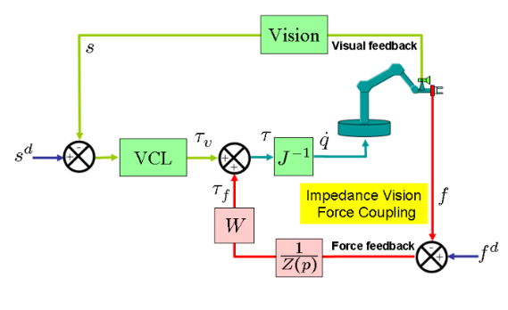
The impedance-based control scheme
L. Cappella M. Cirillo R. Rinaldi

Slide 7
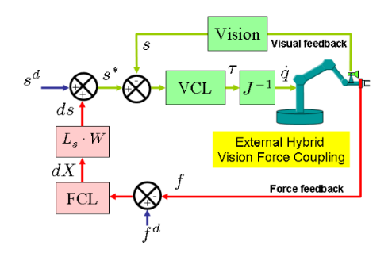
The external hybrid vision/force control scheme
L. Cappella M. Cirillo R. Rinaldi

Slide 8
Focus on the assigned control scheme
L. Cappella M. Cirillo R. Rinaldi

Slide 9
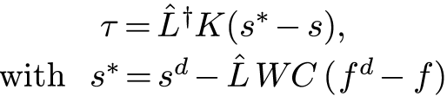
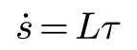
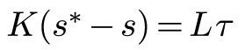
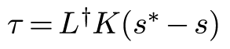
An interpretation
L. Cappella M. Cirillo R. Rinaldi

Slide 10
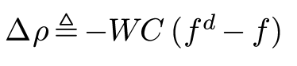
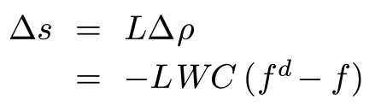
An interpretation
L. Cappella M. Cirillo R. Rinaldi

Slide 11
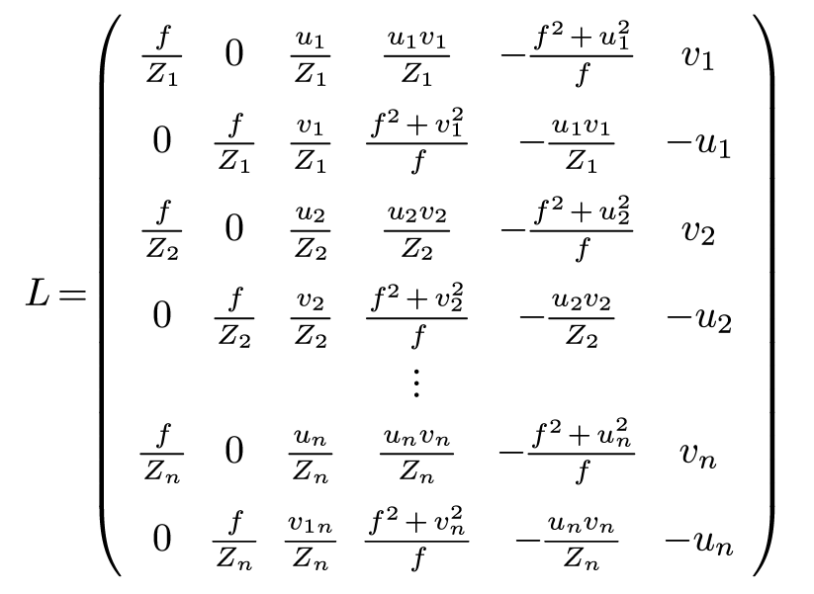
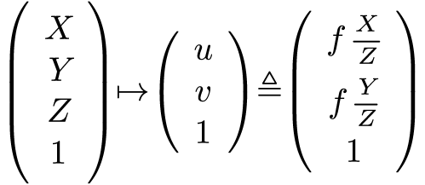
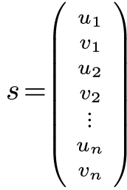
Further details
L. Cappella M. Cirillo R. Rinaldi

Slide 12
Simulation framework
L. Cappella M. Cirillo R. Rinaldi

Slide 13
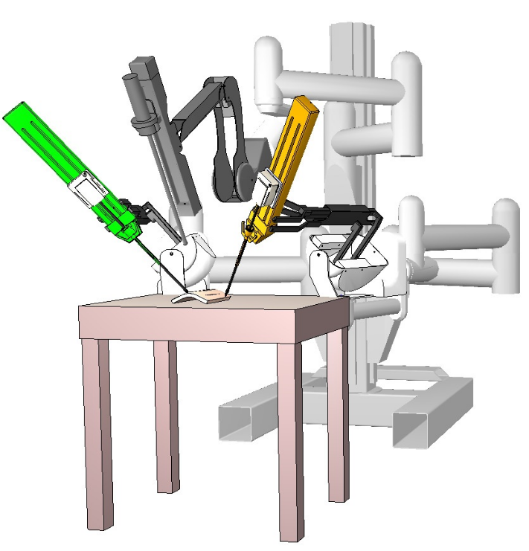
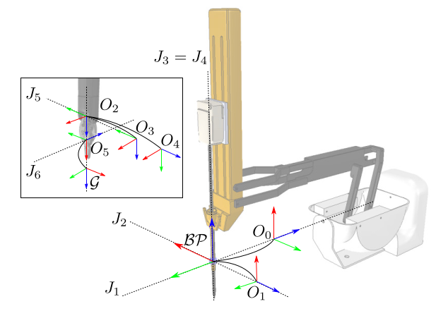
The da Vinci simulator
L. Cappella M. Cirillo R. Rinaldi
Notes:
1

Slide 14
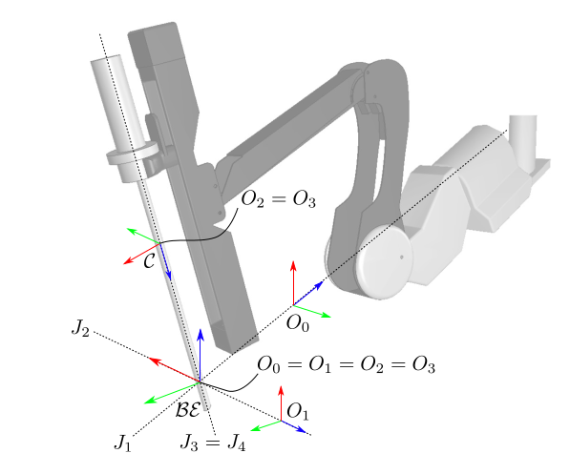
The da Vinci simulator
L. Cappella M. Cirillo R. Rinaldi
Notes:
1

Slide 15
Experiments
L. Cappella M. Cirillo R. Rinaldi

Slide 16
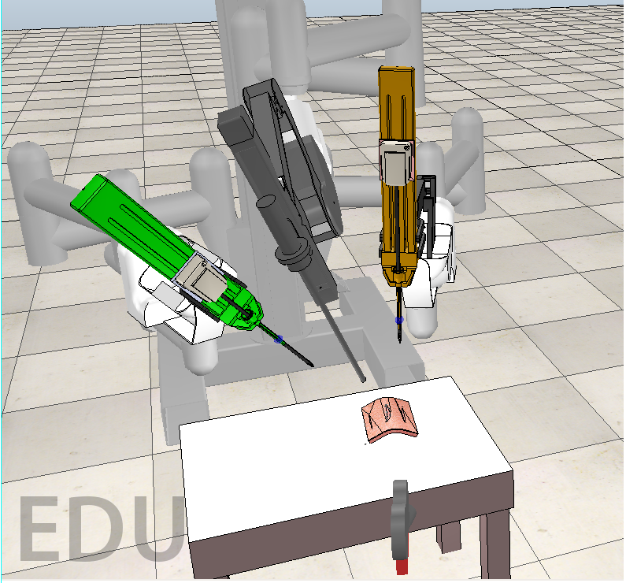
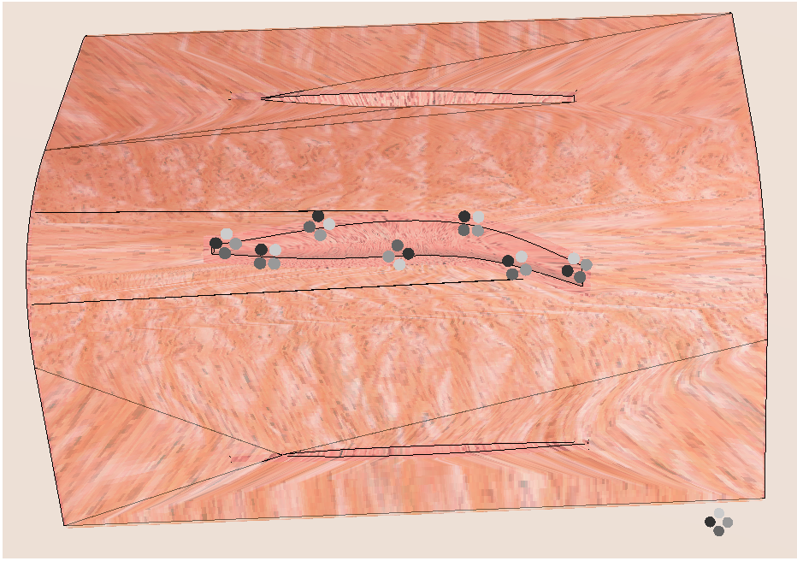
The first experiment
L. Cappella M. Cirillo R. Rinaldi
Notes:
1

Slide 17

The first experiment
L. Cappella M. Cirillo R. Rinaldi
Notes:
1

Slide 18
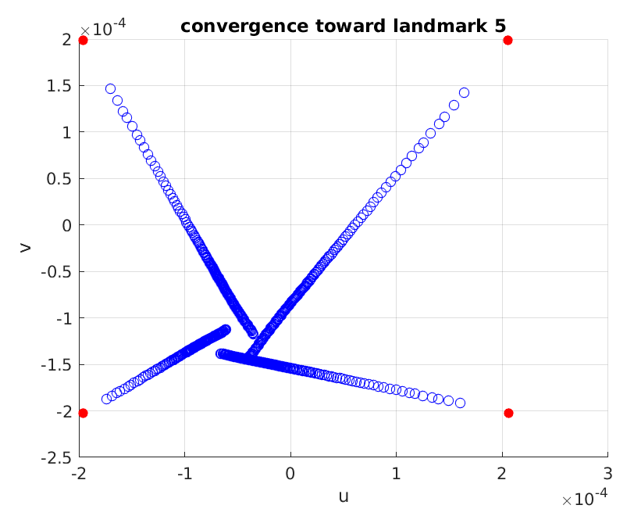
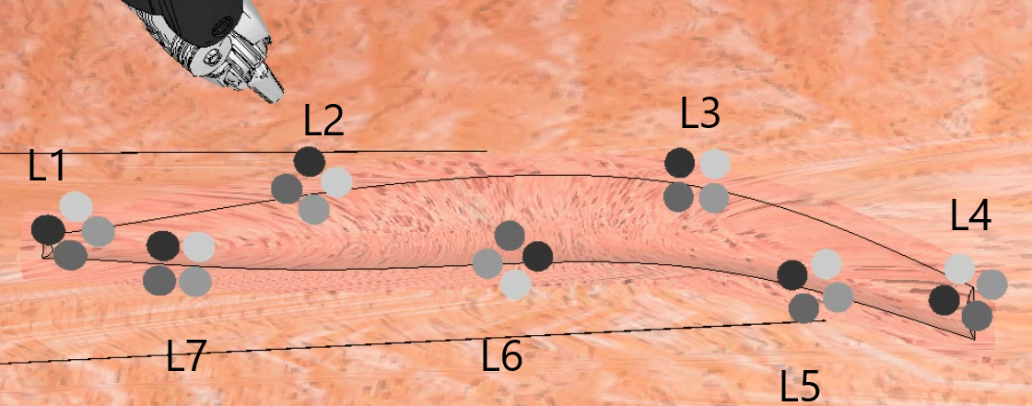
The first experiment
L. Cappella M. Cirillo R. Rinaldi
Notes:
1

Slide 19
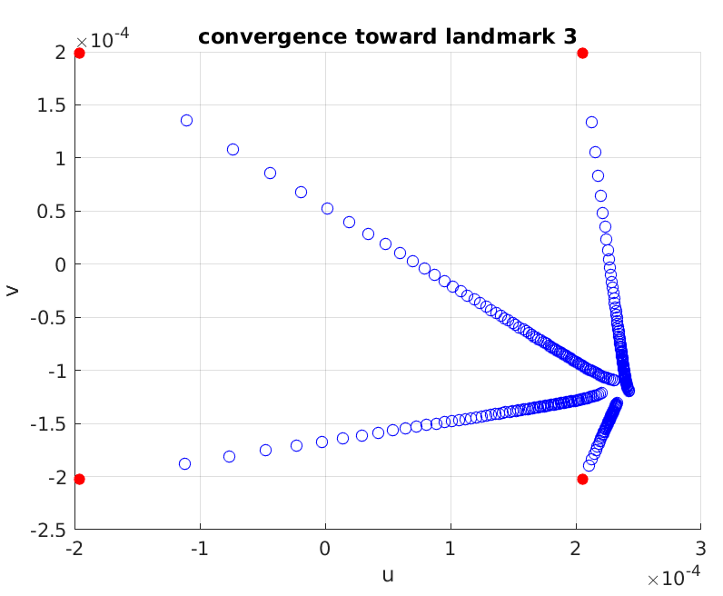
The first experiment
L. Cappella M. Cirillo R. Rinaldi

Slide 20
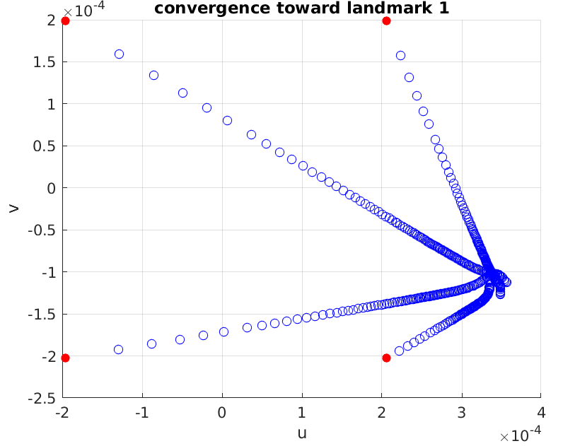
The first experiment
L. Cappella M. Cirillo R. Rinaldi

Slide 21
The second experiment
L. Cappella M. Cirillo R. Rinaldi
Notes:
1

Slide 22
The third experiment
L. Cappella M. Cirillo R. Rinaldi
Notes:
1

Slide 23
An eye-to-hand variant.
L. Cappella M. Cirillo R. Rinaldi

Slide 24
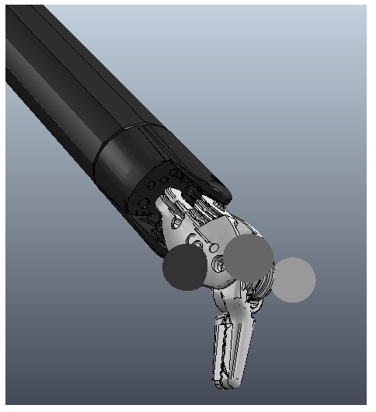
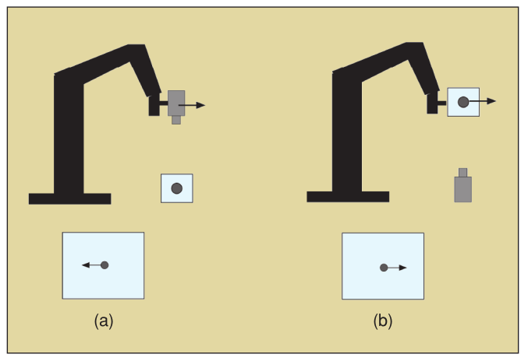
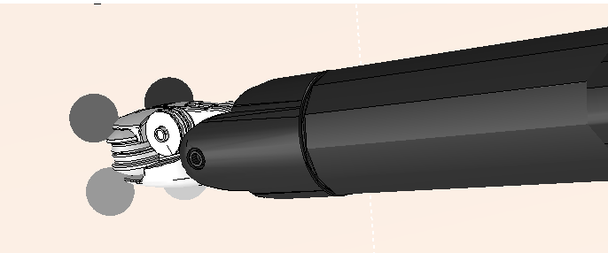
The key differences: 1/4
The features are on the ee.
L. Cappella M. Cirillo R. Rinaldi

Slide 25
The key differences: 2/4
The dimention of is time-dependent.
L. Cappella M. Cirillo R. Rinaldi

Slide 26
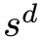
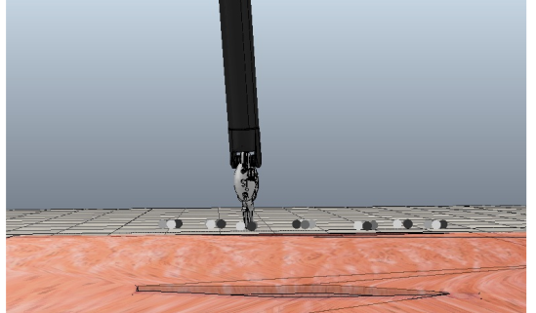
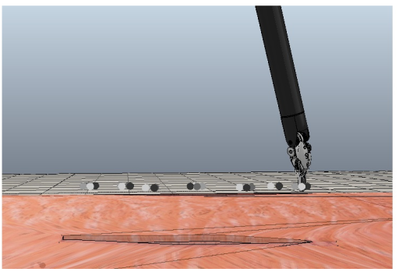
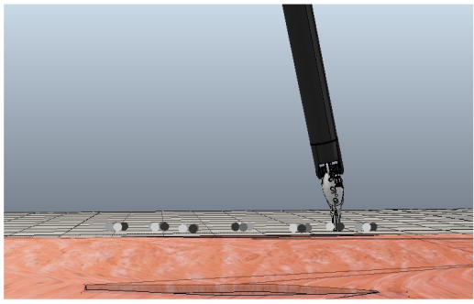
The key differences: 3/4
The value of differs for each landmark.
L. Cappella M. Cirillo R. Rinaldi

Slide 27
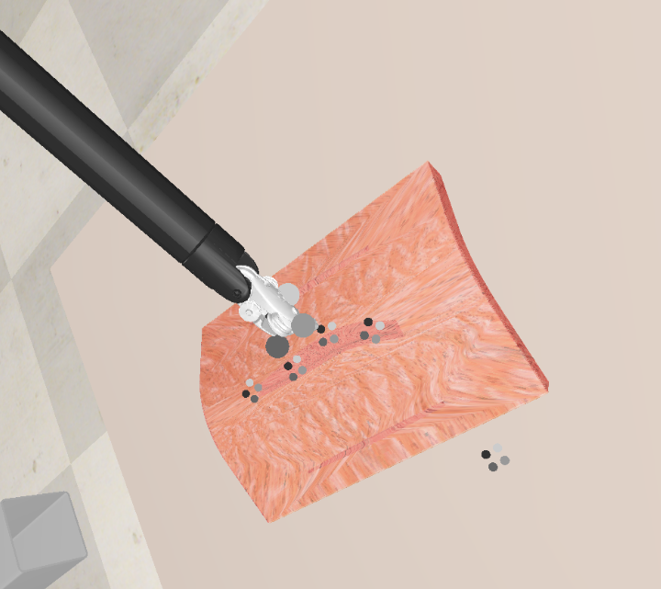
The key differences: 3/4
The value of differs for each landmark.
L. Cappella M. Cirillo R. Rinaldi

Slide 28
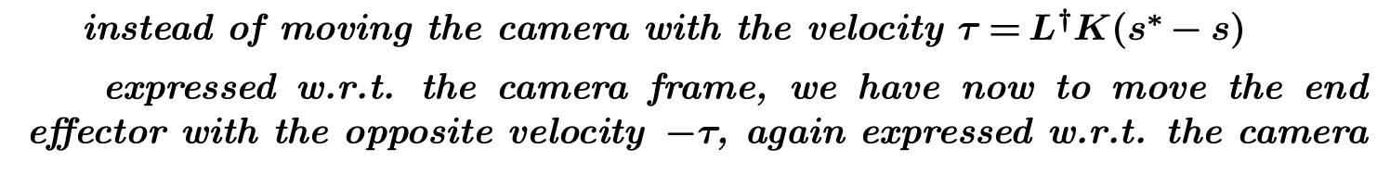
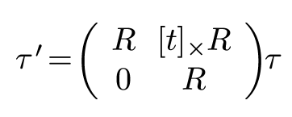
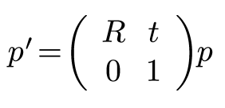
The modified control law.
L. Cappella M. Cirillo R. Rinaldi

Slide 29
The first experiment
L. Cappella M. Cirillo R. Rinaldi
Notes:
<number>

Slide 30
The second experiment
L. Cappella M. Cirillo R. Rinaldi
Notes:
<number>

Slide 31
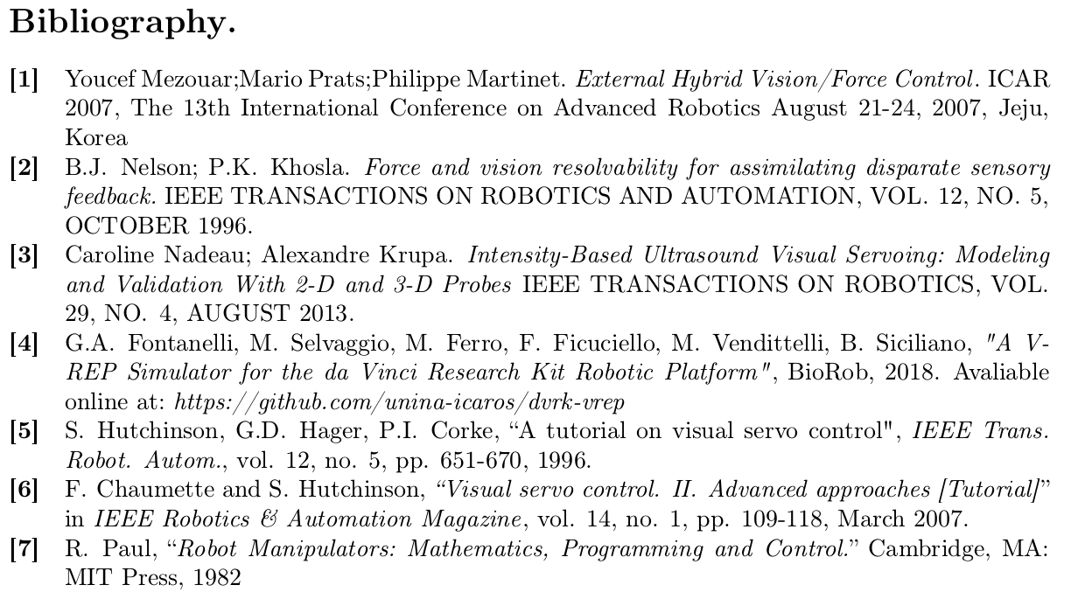
L. Cappella M. Cirillo R. Rinaldi

Slide 32
Thank you for your attention!
L. Cappella M. Cirillo R. Rinaldi

